Slide 1

Domain: MATLAB
Technology: COMMUNICATION
ON THE PERFORMANCE OF QUICKEST DETECTION SPECTRUM SENSING: THE CASE OF CUMULATIVE SUM

Slide 2
Index
Abstract
Introduction
Literature review
Existing Method
Disadvantages
Proposed method
Advantages
Applications
Hardware and Software Requirements
Results
Conclusion
References

Slide 3
Abstract
Quickest change detection (QCD) is a fundamental problem in many applications. Given a sequence of measurements that exhibits two different distributions around a certain flipping point, the goal is to detect the change in distribution around the flipping point as quickly as possible. The QCD problem appears in many practical applications, e.g., quality control, power system line outage detection, spectrum reuse, and resource allocation and scheduling. In this letter, we focus on spectrum sensing as our application since it is a critical process for proper functionality of cognitive radio networks. Relying on the cumulative sum (CUSUM), we derive the probability of detection and the probability of false alarm of CUSUM based spectrum sensing. We show the correctness of our derivations using numerical simulations.

Slide 4
Introduction:
The increasing demand of spectrum slots is a result of the exponential growth of wireless networks. On the other hand, this growth is facing the classical spectrum scarcity problem. Statistical analysis of spectrum usage presented in [1] shows that the spectrum is underutilized. Therefore, interest in cognitive radio (and multi-tier priority access [2]) networks has also grown accordingly. In cognitive radio networks, spectrum slots are allocated to users in a dynamic fashion. At first, the spectrum slot is assigned to its owner, also known as primary user (PU). Users with less priority, also known as secondary users (SU) are allowed to access this designated spectrum slot whenever its owner is not exploiting it. Spectrum sensing is a cornerstone in the deployment of cognitive radio networks.

Slide 5
Cognitive radio
Cognitive radio is an intelligent wireless communication system that is aware of its surrounding environment (i.e., outside world), and uses the methodology of understanding-by-building to learn from the environment and adapt its internal states to statistical variations in the incoming RF stimuli by making corresponding changes in certain operating parameters (e.g., transmit-power, carrier-frequency, and modulation strategy) in real-time, with two primary objectives in mind:
• highly reliable communications whenever and wherever needed;
• efficient utilization of the radio spectrum.

Slide 6
Literature review:
S. NO | Journal Type with year | Authors | Title | Outcomes
1 | IEEE J. Sel. Areas Commun.vol. 23, no. 2, pp. 201–220,Feb. 2005.. | S. Haykin | “Cognitive radio: Brain-empowered wireless communications ,” | Learned about the Cognitive radio
2 | Wireless Netwvol. 25, no. 4, pp. 2041–2064, May 2019 | B. U. Kazi and G. A. Wainer, | Next generation wireless cellular networks: Ultra-dense multi-tier and multi-cell cooperation perspective,” | Studied about UDHetNet, mmWave and CoMP
3 | IEEE Syst. J., vol. 13, no. 1, pp. 18–29, Mar. 2019 | Y. Ye, Y. Li, G. Lu, and F. Zhou | Improved energy detection with Laplacian noise in cognitive radio | Studied the utilisation of CR for the 5th Generation
4 | IEEE Access, vol. 7, pp. 86403–86411, 2019 | N. A. El-Alfi, H. M. Abdel-Atty, and M. A. Mohamed | Sub-Nyquist cyclostationary detection of GFDM for wideband spectrum sensing,” | Studied about the cyclostationarity properties
5 | Cambridge,U.K.: Cambridge Univ. Press, 2008 | L H. V. Poor and O. Hadjiliadis, | Quickest Detection. | Learned about Quickest detection

Slide 7
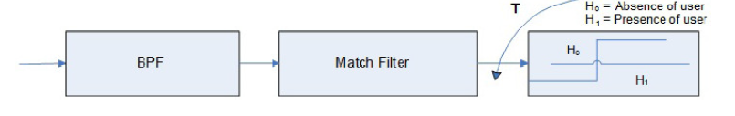

Existing method:
Spectrum sensing can be achieved through different techniques including Matched filter detection and cyclostationary detection .On the other hand, signal detection based on probabilistic models, i.e general-likelihood-ratio test (GLRT) exploits the distributions of the received signal under the two hypotheses (occupied or vacant spectrum slot)
Matched filter detection:
A matched filter (MF) is a linear filter designed to maximize the output signal to noise ratio for a given input signal. When secondary user has a priori knowledge of primary user signal, matched filter detection is applied. Matched filter operation is equivalent to correlation in which the unknown signal is convolved with the filter whose impulse response is the mirror and time shifted version of a reference signal. The operation of matched filter detection is expressed as:

Slide 8
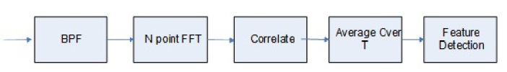
Existing methods:
Where ‘x’ is the unknown signal (vector) and is convolved with the ‘h’, the impulse response of matched filter that is matched to the reference signal for maximizing the SNR. Detection by using matched filter is useful only in cases where the information from the primary users is known to the cognitive users.
Cyclostationary Feature Detection:
It exploits the periodicity in the received primary signal to identify the presence of primary users(PU). The periodicity is commonly embedded in sinusoidal carriers, pulse trains, spreading code,hopping sequences or cyclic prefixes of the primary signals. Due to the periodicity, these cyclostationary signals exhibit the features of periodic statistics and spectral correlation, which is not found in stationary noise and interference.Although it requires a priori knowledge of the signal characteristics, cyclostationary feature detection is capable of distinguishing the CR transmissions from various types of PU signals. Moreover, CR users may not be required to keep silent during cooperative sensing and thus improving the overall CR throughput.

Slide 9
Existing method:
General Likelihood Ratio Test
Spectrum sensing based on GLRT has been presented in which different tests are obtained under different parameter assumptions, i.e., unknown noise variance and/or signal covariance matrix. In the sequel, the GLRT is reviewed in its general form, and it will be employed for the detection of OFDM signals . If any of the two hypotheses describing a binary hypothesis testing problem involves some unknown parameters, the hypothesis is called a composite hypothesis [24]. For a composite hypothesis, one approach is to perform the maximum likelihood estimation (MLE) of the unknown parameters. The estimated parameters are then used in the likelihood ratio test as if they are correct values. The result is then called the generalized likelihood ratio test (GLRT) [24]. This approach enables the cognitive radio receiver to incorporate the uncertainties in calculating the test statistics

Slide 10
Disadvantages in Existing method:
1.One critical problem in detection theory is the quickest change detection (QCD) problem. The objective of QCD is to detect the change point in a series of collected samples or measurements as quickly as possible, i.e., finding the point at which the distribution of the received samples changes.
2. In Cyclostationary Feature Detection, Computationally complex and requires significantly long observation time.
3. In Matched filter detection, It requires a priori knowledge of the primary user signal such as the modulation type and order, the pulse shape, and the packet format. Hence, if this information is not accurate, then the matched filter performs poorly.
4. Matched filter based detection is complex to implement in CRs.

Slide 11
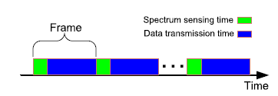
Proposed method:
We consider an SU operating in frame basis as depicted in Figure below. The time is partitioned into frames of equal length. Each frame consists of a spectrum sensing phase and data transmission phase. In case the decision during the spectrum sensing phase is declared to be existence of the PU’s signal, the SU remains silent during the data transmission phase since the frame belongs to the PU. Otherwise, the SU starts to exploit the data transmission phase to transmit and receive its own data.
Figure:Periodic spectrum sensing.

Slide 12

Proposed method:
The spectrum sensing operation has two cases:
A) Detection of the entrance of the PU’s signal; or
B) Detection of exiting of the PU user, i.e., empty spectrum frame.
CUSUM Algorithm :CUSUM algorithm is based on LRT [6]. When the spectrum slot is vacant, the collected samples by the SU follow a certain distribution, say distribution F0, with density function f0. Ditto, as the PU starts using the frequency band, the distribution changes to F1 with density f1. In this case, the detection of the entrance of the PU’s signal is a sequential change detection problem where the received samples are processed sequentially and the decision statistic is calculated after each sample. The decision on the occupancy status of the spectrum is also made sequentially. To this end, the log likelihood ratio is calculated for each sample y[l] sequentially through:

Slide 13
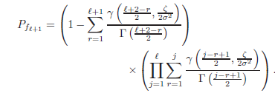
Proposed method:
Using CUSUM algorithm, after the spectrum status changes, as the number of collected samples increases, the probability of detection increases and, eventually, can reach its maximum value,. However, within the paradigm of periodic sensing, depicted in Fig. 1, the total number of collected samples is bounded by the periodic sensing time. To this end, when applying CUSUM algorithm in cognitive radio applications where the size of the detection window is fixed, i.e., finite number of collected samples is used, the receiver operating characteristics (ROC), determined by the probability of false alarm and the probability of detection, are key performance metrics related to deciding on the status of the spectrum.
closed-form expressions for the detection and false-alarm probabilities of the decision statistic of the CUSUM test, The distribution of the received signal under the two hypotheses is the same mentioned above
The false-alarm probability for the sample, is given by

Slide 14

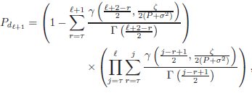




Cont..
The total false-alarm probability is given by
In addition, the detection probability is given by:
Where
is the threshold,
c1 = ,
is the lower incomplete gamma function, and Γ(·) is the gamma function. The total detection probability is given by

Slide 15
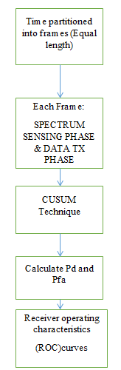
Block diagram of proposed method

Slide 16
Advantages of Proposed method:
Advantages:
1.The QCD(Quickest Change Detection ) problem is solved by using CUSUM Algorithm
2.The proposed QCD BASED ON CUSUM,requires less observation time and less in complexity .
3.No priori knowledge of the primary user signal such as the modulation type and order, the pulse shape, and the packet format is required .
4. Proposed QCD BASED ON CUSUM performs better when compared to other spectrum sensing techniques
5.unlike Matched filter based detection is complex to implement in CRs,the proposed method is implemented in CR.

Slide 17
Applications of Proposed method:
1.Spectrumsensing ,
2.Resource allocation and scheduling .
3.Powersystem line outage detection
4.Bioinformatics
5. Quality control.

Slide 18
Hardware and Software Requirements:
Hardware & Software Requirements:
Software: Matlab R2018a.
Hardware:
Operating Systems:
• Windows 10
• Windows 7 Service Pack 1
• Windows Server 2019
• Windows Server 2016
Processors:
Minimum: Any Intel or AMD x86-64 processor
Recommended: Any Intel or AMD x86-64 processor with four logical cores and AVX2 instruction set support
Disk:
Minimum: 2.9 GB of HDD space for MATLAB only, 5-8 GB for a typical installation
Recommended: An SSD is recommended a full installation of all Math Works products may take up to 29 GB of disk space
RAM:
Minimum: 4 GB
Recommended: 8 GB

Slide 19
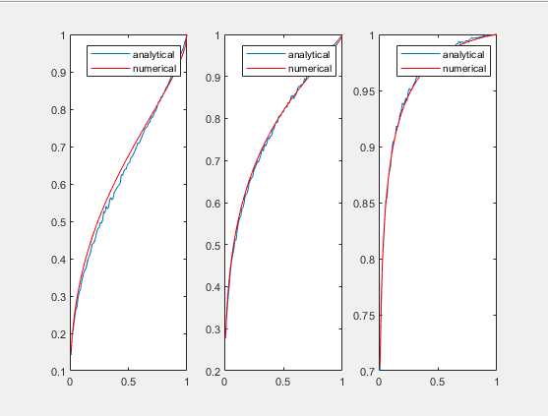
Results and Discussions:
The results of the proposed method are as follows:
Figure:ROC curves for numerical and analytical simulations for SNR = -10 dB.

Slide 20
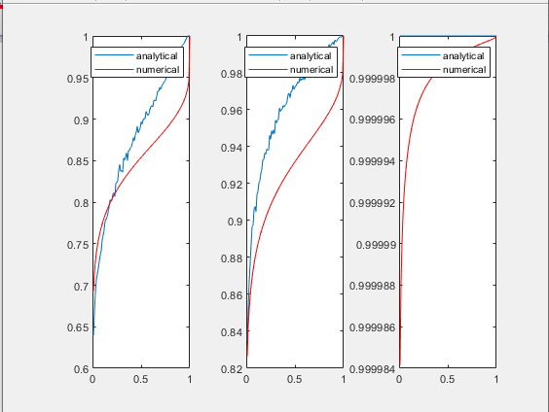
Results and Discussions:
Figure:ROC curves for numerical and analytical simulations for SNR = 3 dB.

Slide 21
Conclusion:
We derived closed-form expressions for the probability of false alarm and probability of detection for QCD-CUSUM sequential test. Spectrum sensing is used as an application of CUSUM test with detecting the entrance of PU signal as the example. Through simulation comparison between analytical and numerical results, we showed that our derived expressions provide a very close approximation. The provided results can be used in all applications that require channel sensing and will simplify the optimization formulation procedures to achieve better performance for various applications

Slide 22
References:
[1] S. Haykin, “Cognitive radio: Brain-empowered wireless communications,” IEEE J. Sel. Areas Commun., vol. 23, no. 2, pp. 201–220, Feb. 2005.
[2] B. U. Kazi and G. A. Wainer, “Next generation wireless cellular networks: Ultra-dense multi-tier and multi-cell cooperation perspective,” Wireless Netw., vol. 25, no. 4, pp. 2041–2064, May 2019.
[3] Y. Ye, Y. Li, G. Lu, and F. Zhou, “Improved energy detection with Laplacian noise in cognitive radio,” IEEE Syst. J., vol. 13, no. 1, pp. 18–29, Mar. 2019.
[4] N. A. El-Alfi, H. M. Abdel-Atty, and M. A. Mohamed, “Sub-Nyquist cyclostationary detection of GFDM for wideband spectrum sensing,” IEEE Access, vol. 7, pp. 86403–86411, 2019.
[5] S. M. Kay, Fundamentals of Statistical Signal Processing: Detection Theory. Englewood Cliffs, NJ, USA: Prentice-Hall, 1998.

